Slide 1
DAMAGE ASSESSMENT
1)Why Damage assessment?
2)Objectives
3)Assessment report
4)Steps to be followed
5)Case studies-Tsunami Modelling

Slide 2
Why Damage Assessment?
Damage assessment is a prerequisite for all disaster management practices. Assessing the level of damage is required at two basic levels of intervention.
Firstly, for emergency relief measures, for which purpose a quick assessment of damage would become the basis for the amount of medical relief and food stocks to reach the disaster area quickly. At the second level, would be a detailed technical analysis of the damage for long-term restoration and rehabilitation works. Form a long-term perspective, realistic damage assessment examines the mechanisms of failure that take place during the disaster. These studies are very useful for all future prevention and mitigation efforts regarding disasters.
Notes:
Two levels of assessment 1)Food and medicines 2)Technical Support

Slide 3
Objectives of Damage Assessment:
I. To make rapid assessment of areas affected and the extent of impact, for the purpose of immediate rescue and relief operations,
II. To prepare estimates for the amount and type of relief to be provided and mode of relief, in terms of food, clothing, medicines, shelter and other essential items,
III. To make detailed assessment for long-term relief and rehabilitation planning and
IV. To identify focus areas for purpose of replication in similar situations.
Notes:
damage assessment is an important tool to assimilate and document the extent of impact of a disaster, and forms the basis for disaster management actions.

Slide 4
Damage Assessment Includes:
I. Identification of information needs and sources of reliable data;
II. Collection of data;
III. Analysis and interpretation of data;
IV. Report writing;
V. Conclusion; and
VI. Recommendation for planners and decision makers.

Slide 5
Hierarchy of officials
As usual, there is a hierarchy of officials who report from the lowest level of villages/panchayats through blocks/ revenue circle, tehsils/talukas, sub-divisions and finally to the districts.
The official agency for reporting estimates of disaster damages is the Revenue Department of the state Government, as they are also the authority for granting and distributing relief to the affected persons

Slide 6
Assessment report contains:
Name of sub-division
Area in square kilometers
Total number of villages
Number of villages affected
Total population
Population affected
Total number of panchayats
Number of panchayats fully affected
Number of panchayats partially affected
In case of floods, areas still under water

Slide 7
Reports involved in Damage Assessment:
Flash report
Initial report
Interim reports
Technical report
Final report

Slide 8
Steps to be followed:
1)Form assessment teams 8)Collect baseline info
2. Develop Standard Operating Procedures 9)Training/simulation
3. Team equipment and tools
4. Identify information users and needs
5. Design survey forms
6. Identify data collection methods
7. Standard briefing instructions

Slide 9
1)Form assessment teams
Multidisciplinary teams
• Volunteerism is the essence
• Composed of small size, during actual deployment.

Slide 10
2)Develop standard operating procedures:
1)Team activation
2)Team roles/individual roles
3)Logistics,Transport
4)Communication
5)Staff safety
6)Reporting requirements

Slide 11
3)Team equipment and tools:
1)Prepare survey team equipment list
2)Keep the necessary materials ready
3)Setting up a tent,life jacket,map reading-Team members must be aware of this
Checklist:
Area maps (preferably laminated) • Water soluble markers for laminated maps • Notebooks or pads • Pencils/pens • Binoculars • Camera and spare film • Fluids (coffee/tea) • Rations • Anti-motion sickness tablets • Sick bags (for aerial inspection) • Personal equipment (sunglasses, suitable clothing, caps)

Slide 12
4)Identify information needs and users
• Identify needs before hand to save timeat the actual time of collection
• Prioritize information needs
a)Essential b)Background
• Who will be the potential users of these information.
Information may be useful for media and general public

Slide 13
5)Design Survey Forms
Various kinds of reports are needed - technical, official, confidential and those for public release through the media for effective response.
• Common format to be developed and used.
Designed by multiple users related to assessment and response
• Design in consultation with specialists in each sector
• Clear • Easy to complete

Slide 14
6)Data collection methods
Informal reports
Visual inspections
Interviews with key informants
Special interviews

Slide 15
7)Standard briefing instruction:
Purpose of the survey
• Team organization • Team equipment
• Areas to be surveyed • Information sectors to be covered
• Standard terms and their meanings • Techniques for obtaining information
• Reporting requirements

Slide 16
8)Collecting baseline information
Comparison of survey with Baseline information is valuable for response and recovery plans.
Specialist government agencies keep baseline information.
NGOs should include contacts of relevant agencies through which baseline information can be obtained

Slide 17
Baseline data
• Area maps and plans
• Census and statistics agencies
• National, state and local government Maps
• Statistics
• Plans
• Lists of agency staff • Government resources • Community capacities
Notes:
Contact numbers for agencies, donors, superiors, embassies, media, specialized technical experts
Baseline data should be up-dated from time to time, so that it is relevant and reliable when needed

Slide 18
9)Simulation/Training:
• Use of survey forms
• Reporting requirements and process
• Living in the field • Use of equipment and tools
• Personal safety
• Simulations to enhance learning
• Team wide debriefing on lessons learnt at the end of each mission.

Slide 19
Context of Damage assessment
Primary focus:
– Buildings (Residential, Office, Commercial, Lifeline etc.)
– Roads and Bridges
– Water supply and sanitation structures
– Dams and other irrigation structures
– Industrial facilities (including power plants) – Ports and other coastal structures
– Electrical and Communications system structures

Slide 20
Structures which are owned by multiple agencies of the government
• Structures that may require government funds for repairs or rehabilitation (including private buildings)
• Structures that affect a large number of people
Buildings
Bridges
Tanks and reservoirs

Slide 21
Secondary focus for DA:
Structures owned or operated by specialised agencies
• Very complex structures that require highlevel technical skills for assessment
Complex industrial facilities
Port and harbour structures
Petrochemical infrastructure
Dams Roads
Electrical generation & transmission networks, etc

Slide 22
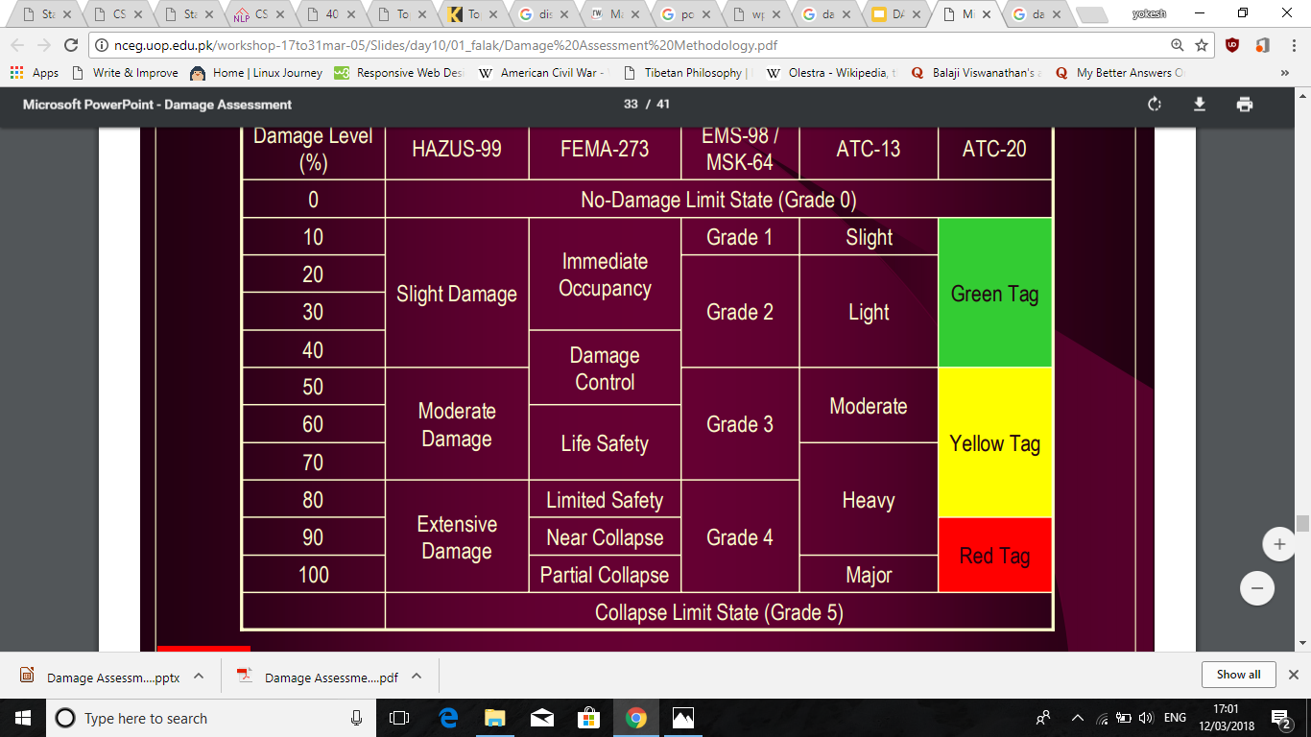
Notes:
Grade column - earthquake
LAst column-rapid assessment
Second -Value of damage

Slide 23
Remote sensing:
Passive sensors:
The passive sensor system, where the electromagnetic radiation from the sun hits the Earth surface and then is reflected to the satellite sensor. Thus, passive sensors measure the electromagnetic radiation or natural energy at specific wavelengths which can vary from visible to infrared, ultraviolet or other wavelength ranges known as bands. An example of passive sensor data can be found under the Landsat mission program
Notes:
Multiple methodologies are available for conducting damage assessment and damage estimation, from telephone and radio communication to the dispatch of reconnaissance teams on ground and air. However, when the access and telecommunication supply is broken or limited, or when there is risk of secondary disasters like fire, nuclear accidents, etc., these methods are difficult to put on practice. In recent years, to grasp the situation and impact of remote and wide areas, satellite imagery has been used to acquired information of possible damage extent and evaluation of needs for humanitarian action. Remote sensing technique is at the forefront of damage assessment and damage estimation of large areas.

Slide 24
Active Sensor System:
In this case, active sensors create their own source of illumination and measure the backscattered waves. Thus, active sensors do not depend on sun energy emission. Some examples of active sensors are LiDAR and radar sensors. The advantage of active sensors is that they can be used at any time of the day because they do not require natural light. Also, active sensors are generally not affected by cloud coverag

Slide 25
Tsunami Modelling:
t
In the case of tsunami events, to assess or estimate the damage extent (i.e. inundation area) and the damage to buildings, tsunami numerical simulation can be applied. First, a plausible tsunami source is determined. Tsunami events can be triggered by earthquakes, landslides, volcano eruptions or other very low frequent events like the impact of solid bodies from outer space into the ocean. Relative frequent events are earthquakes triggered by the released of energy accumulated due to subduction of tectonic plates under the sea. While other mechanisms of earthquakes exist, it is in the thrust fault associated to the abruptly move of plate boundaries the one that, more specifically, can generate a tsunami. The water displacement propagates throughout the ocean until coastland areas where the energy carried on waves is finally dissipated by friction and the presence of topography elevation

Slide 26
Evacuation model
Goto et al. (2012) The model uses multi agent systems moving on a road network map and following predefined rules. Some assumptions in this model are that (i) agents follow the shortest paths through a linked network. Short in terms of distance for pedestrians and time for vehicles. (ii) fast evacuees pass slower ones when space is available, and (iii) vehicle speed depends on road width. For this model, the model unit agent is the family (4 persons). Three kinds of agents are shown, i.e., the family walking, the family in a car, and 2 members of the family on a motorcycle. Tsunami casualties are counted when inundation depth exceeds 1.00 m at the actual location of an agent. In this case, there is a limitation on the representation of individual behavior and outcome for each evacuee.

Slide 27
• Watanabe and Kondo (2009) The authors present a tsunami evacuation model based on a multi agent system approach. Each evacuee is an agent with the characteristics of age, speed, fatigue level and disaster mitigation awareness. Interaction of these data with the environment describes the evacuation behavior. The model considers only agents as pedestrians and there is no vehicle simulation for traffic conditions. Evacuation start time is also strictly based on questionnaire data. Departure times are based on situational conditions that trigger protective action.

Slide 28
With evacuation simulation models, it is possible to analyze alternatives for safer routes, destinations, evacuee response and other possible decisions for disaster mitigation in an area (Southworth, 1991; Kietpawpan, 2008). Emergency evacuation models may be classified at first on: (i) large-scale scenarios, e.g. hurricanes, nuclear power plants, tsunami, etc. and (ii) small-scale evacuation of buildings or vessels due to bomb threats, fire, etc. Traditionally, large-scale scenarios were modeled following a macroscopic approach with vehicular evacuation. In macroscopic models the flow or group of individuals on the move is the smallest unit simulated. In recent years, researchers are focusing on the microscopic simulation of individuals. Here, an agent or individual is the smallest unit simulated. Although it is the individual who is the main element during the develop stage, final attention lies on the overall emergent behavior of agents interaction. This is possible due to the fast development of computing capacity in memory processes, graphic rendering and data storage.

Slide 29
Layer 0:
• Layer 0, evacuation decision: The timing for starting evacuation is assigned randomly to each agent based on tsunami departure curves that models start time behavior through the stochastic simulation of random selected time bound by two Rayleigh distributions. The first curve is obtained from the distribution of the stated preference survey and the second is based on Rayleigh distribution with a mean equal to the estimated tsunami arrival time obtained from numerical simulation

Slide 30
Layer 1:
Layer 1, shelter decision: There are two possible options for scenario exploration: first, the nearest shelter is selected by an agent based on direct Euclidean distance measure and, second, any shelter can be selected randomly. Traditionally, the nearest shelter condition has been applied. In many cases, however, preferences are not for the nearest shelter.

Slide 31
Layer 2:
• Layer 2, route decision and path finding: The method used for finding a route -not necessary the shortest- is the A* (A star) algorithm with heuristics in grid space. This is the most popular graph search algorithm used in the video game industry Anguelov (2011).
Layer 3:
Layer 3, speed adjustment: Speed variation is assumed to be a one-tail normal distribution of evacuee density in the agent field of view, with a maximum value of 1.33m/s for pedestrians and 30km/h (8.33m/s) for cars Meister (2007); Suzuki and Imamura (2005).

Slide 32
Application of model:
The model was verified using the 2011 Great East Japan Earthquake and Tsunami data from the evacuation in Arahama, Sendai (Mas et al., 2012b) and Yuriage, Natori in Japan (Takagi et al., 2014). In addition, for casualty estimation, other examples in Padang, Indonesia (Imamura et al., 2012); Pakarang, Thailand (Mas et al., 2013b); and Lima, Peru (Mas et al., 2013a) can be found in the literature

